Slide 1
A Framework for Detecting Clusters and Anomalies on a Blockchain By Nima Imani and Kamran Rahman

Slide 2
Problem Statement
Organization seeking to develop compliance in their blockchain-related businesses, are faced with the ambiguity and anonymity behind blockchains.

Slide 3
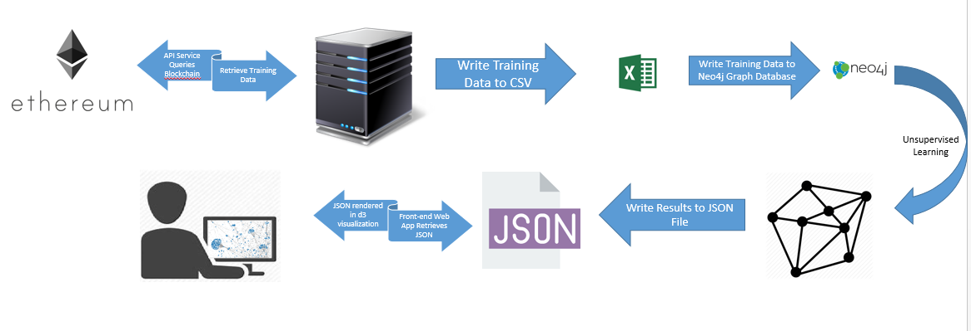
The solution
A framework for identifying clusters and anomalies on a distributed ledger.

Slide 4
Use-cases
AML compliance
For example, organizations like Coinbase will need a way to demonstrate AML compliance. The prototype provides a framework for identifying cases where money laundering may be present.
Digital heists
$15 billion in Bitcoin has been digitally stolen since 2009 (https://www.fastcompany.com/40505199/bitcoin-heist-adds-77-million-to-hacked-hauls-of-15-billion)
Phishing rings

Slide 5
Strengths of Prototype
Crypto-currency agnostic
Built on open-source software
Can be used on both permissioned and non-permissioned networks.

Slide 6
Recommended Mid-term Roadmap
Upgrade API account with BlockCypher for collecting more transaction data.
Continue to run application under an unsupervised model.
Begin labeling nodes to prepare for transition to supervised model.
Automate prototype in an effort to make it easy for non-technical users to consume.
Build a backlog for identifying other feature development opportunities.

